Slide 1
WORD AUTO COMPLETE
Presented By:
Arvinth Kumar.S (1831006)
Boobalaragavan.P(1831009)
Muthu Rahul(1831031)
Prakash.N(1831033)
Ruthsan.R(1831045)

Slide 2
AIM OF THE PROJECT
To search for the names of the book stored in a trie structure.
The book availability is searched by the use of autocomplete feature.
.

Slide 3
Problem Definition
Trie data structure is used to store and the user can search the book that he/she requires easily.

Slide 4
What is a Trie?
The Word trie is an infix of the word “ RETRIEVAL “.
Trie is nothing but a tree and each node in it contains the numbers of pointers equal to the number of characters.
• Trie is a optimized data structure used for specific type of searching.

Slide 5
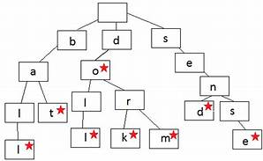
Example of a Trie Structure:

Slide 6
Why Trie?
The Tries can insert and find Strings in O(L) time , which is must faster than Hash tables and Binary Search Trees.
here L = length of a single word.
A Binary Search Tree Which Stores each Word as a node Requires O(log(n)) time to search.
here n = no of nodes in BST.

Slide 7
Concept Used
Trie Data Structure
Exceptional Handling
Date Function
Dat Files

Slide 8
Application of Auto Complete:
The auto complete feature is used to suggest the names of the existing books stored in the library.
It helps in faster retrieval by providing auto suggestions of the books which match the entered prefix.

Slide 9
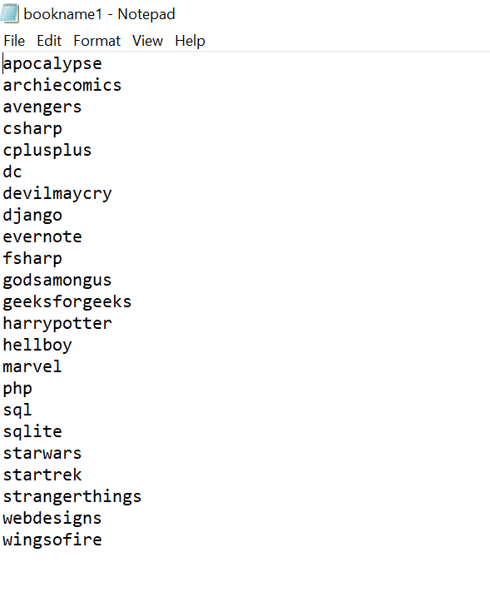
Sample File

Slide 10
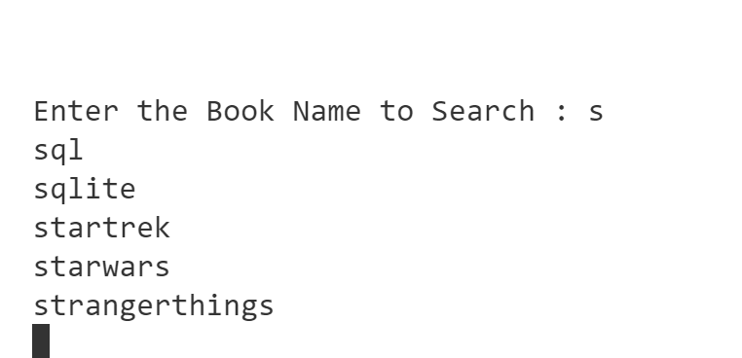
Output

Slide 11


